Slide 1
Chapter 3 – Expressions
Semantics of Programming Languages via Interpreters

Slide 2
LET : A Simple Language
שפת "ויהי"

Slide 3
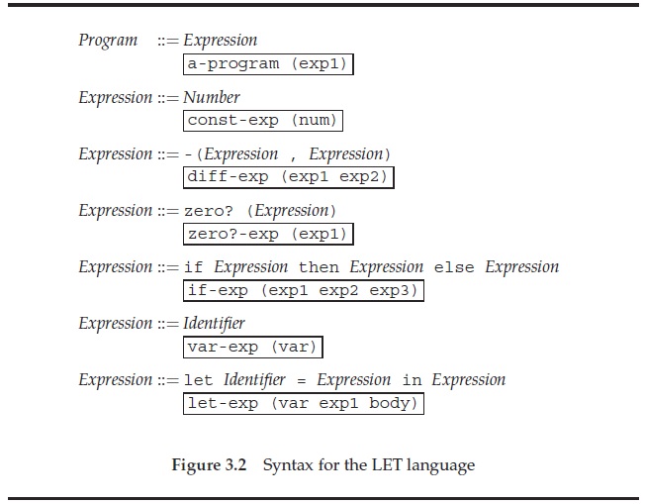

Slide 4
Examples in the LET language
let x = 5 in -(x,3)
let z = 5 in let x = 3 in let y = -(x,1) % here x = 3 in let x = 4 in -(z, -(x,y)) % here x = 4
let x = 7 in let y = 2 in let y = let x = -(x,1) in -(x,y) in -(-(x,8), y)

Slide 5
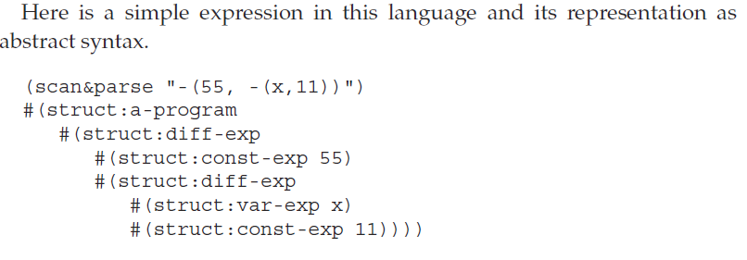

Slide 6
Specification of Values
Expressed values
ערכים שמוחזרים מחישוב של ביטויים
(ערכם שניתנים לחישוב)
Denoted values
ערכים שכרוכים למשתנים
(ערכים שניתנים לציון)

Slide 7
Values in LET Language
ExpVal = Int + Bool
DenVal = Int + Bool

Slide 8
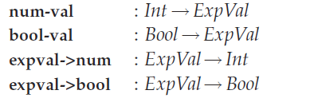
ממשק לעבודה עם ערכים שניתנים לביטוי
(Expressed values)

Slide 9
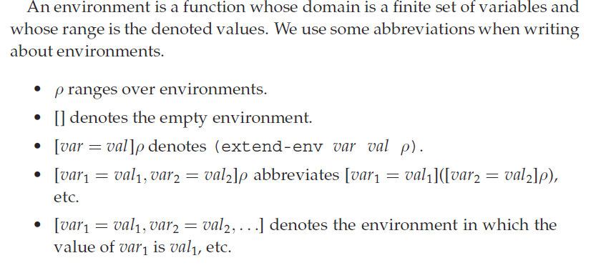
Environments

Slide 10
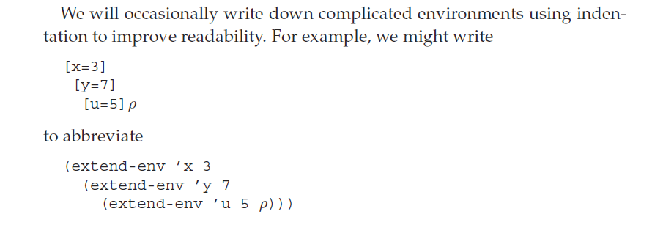

Slide 11
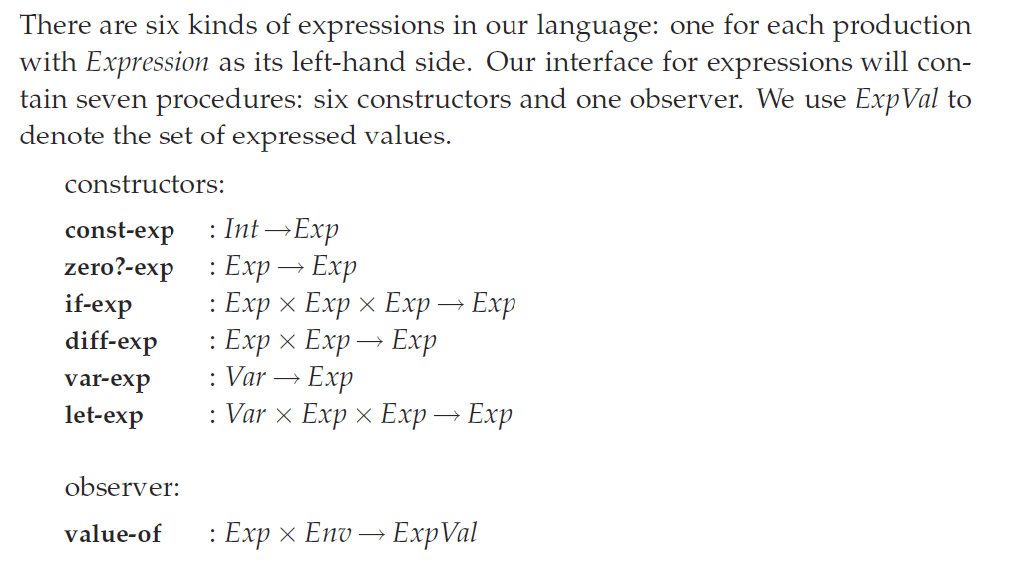
Specifying the Behavior of Expressions

Slide 12
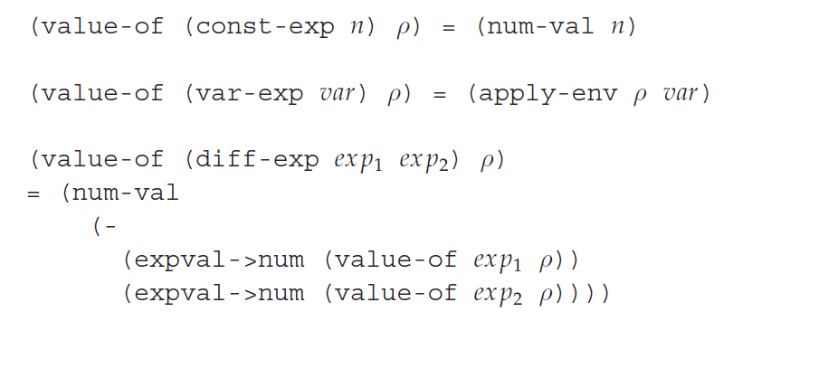
Spec of value-of
Three more remaining.
Notes:
Note the Scheme minus.

Slide 13


Notation
Notation | Denotes
ρ | env
[] | Empty env
[ var = val ] ρ | (extend-env var val ρ)
«exp» | AST for expression exp
⎡n⎤ | (num-val n),
 | (expval->num val).
 | Note:

Slide 14
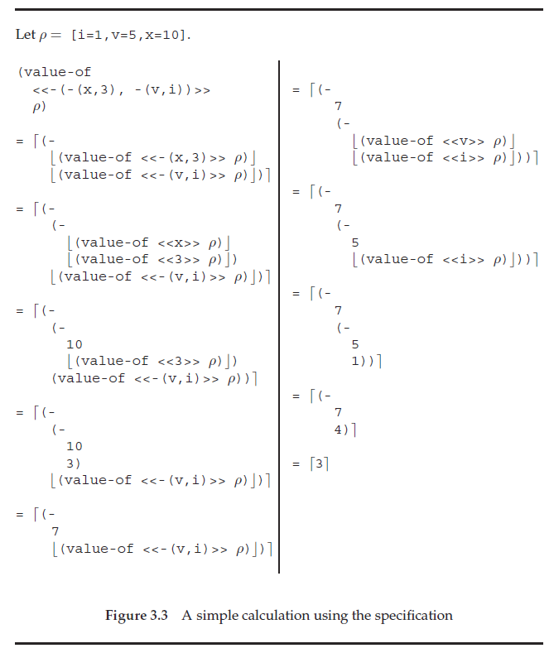
Figure 3.3 An example calculation

Slide 15

Specifying Programs
initial environment
[i=1, v=5, x=10]

Slide 16
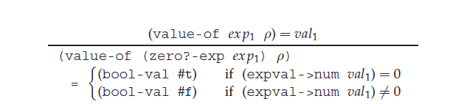
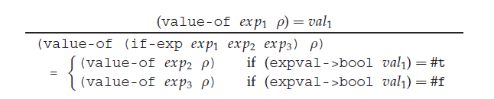
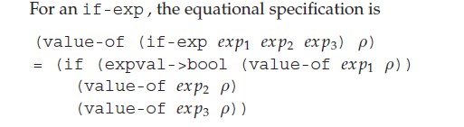
Spec of value-of

Slide 17
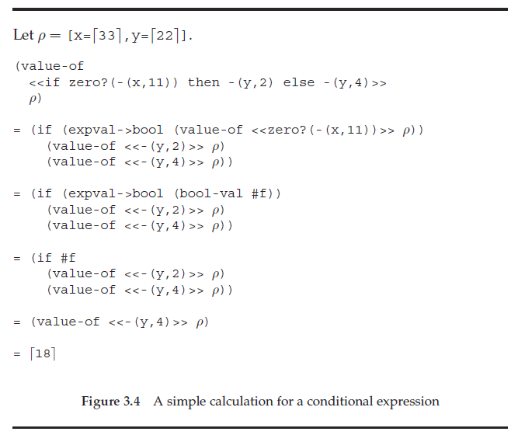
Fig 3.4 A conditional expression

Slide 18
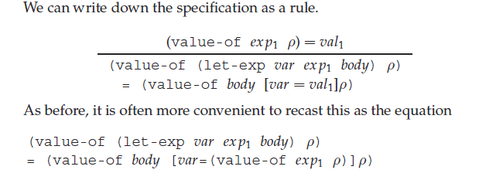
Eval of an example let

Slide 19
Fig 3.6 LET lang AST def
(define-datatype program program? (a-program (exp1 expression?)))
(define-datatype expression expression?
(const-exp
(num number?))
(diff-exp
(exp1 expression?)
(exp2 expression?))
(zero?-exp
(exp1 expression?))
(if-exp
(exp1 expression?)
(exp2 expression?)
(exp3 expression?))
(var-exp
(var identifier?))
(let-exp
(var identifier?)
(exp1 expression?)
(body expression?)))

Slide 20
(init-env) = [i= 1,v= 5,x=10]
(define init-env
(lambda ()
(extend-env
'i (num-val 1)
(extend-env
'v (num-val 5)
(extend-env
'x (num-val 10)
(empty-env))))))

Slide 21
Fig 3.7a Expressed values
(define-datatype expval expval? (num-val (num number?)) (bool-val (bool boolean?)))

Slide 22
Fig 3.7b Expressed values
(define expval->num
(lambda (val) (cases expval val (num-val (num) num) (else (report-expval-extractor-error
’num val)))))

Slide 23
Fig 3.7c Expressed values
(define expval->bool (lambda (val) (cases expval val (bool-val (bool) bool) (else (report-expval-extractor-error `bool val)))))

Slide 24
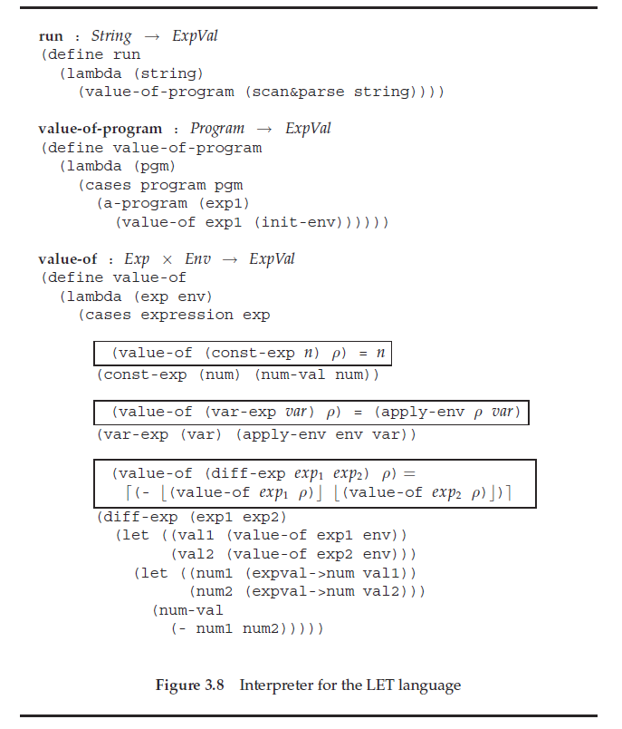
value-of: Exp × Env → ExpVal

Slide 25
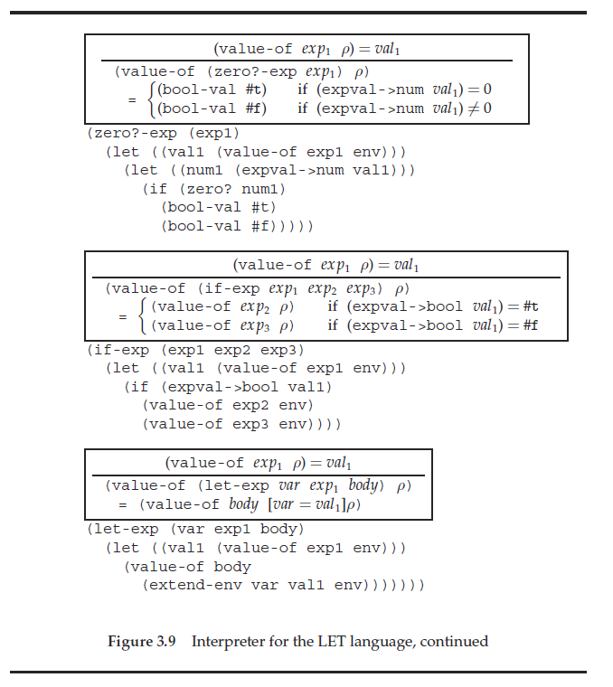
value-of-program – cont’

Slide 26
Racket
הדגמת בניית מפרש לשפת "ויהי"

